Slide 1


Abbie Purdie Modeling

Slide 2
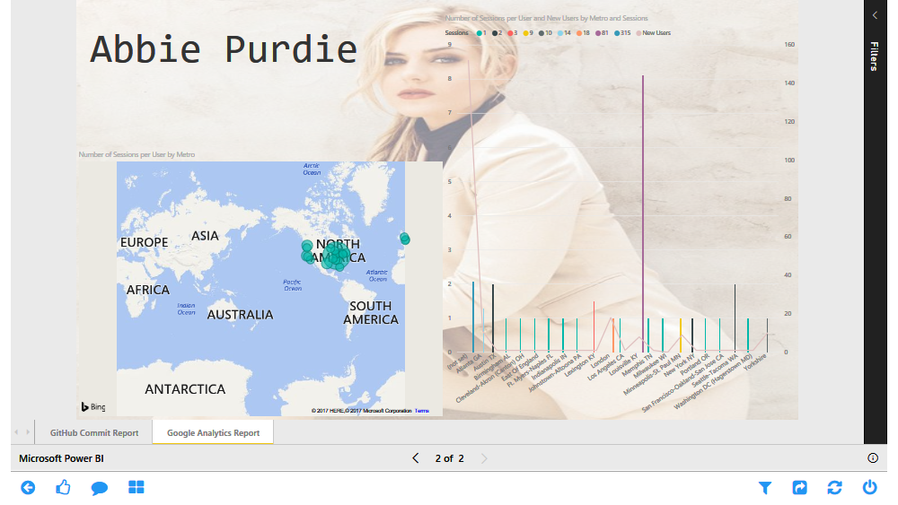

Slide 3
